Slide 1
Platform Security Protecting the things that run your code
Andrew Paverd (Secure Systems Group)

Slide 2
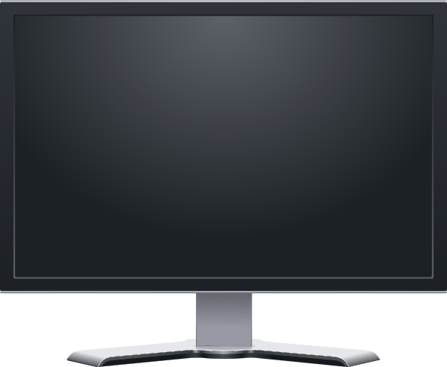
Trust in computing
App 1
App 2
Do you trust a computer (platform) to behave as expected?
What hardware/software is running?
Will this behave as expected?
Operating System

Slide 3
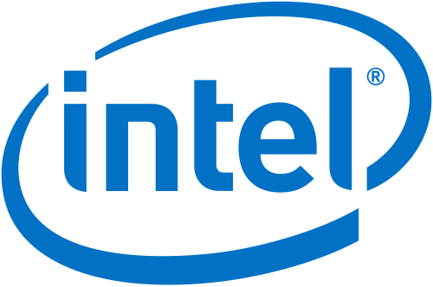
Trusted Execution Environment (TEE)
App 1
App 2
Isolated execution of critical code
Reduce the amount of code to trust
Secure persistent storage
Protect secrets and sensitive data
Remote attestation
Prove what code is running
TEE
Operating System
TEE

Slide 4
Storing web passwords
Web Server
f(p,s), s
f(p,s), s
salt (s)
Browser
f
password (p)
=?
[secure channel]

Slide 5
Stealing web passwords
Web Server
Web Server
f(p,s), s
f(p,s), s
f(p,s), s
salt (s)
web page
Browser
f
password (p)
=?
[secure channel]

Slide 6
Keeping web passwords safe
Web Server
f(k,p,s), s
salt (s)
web page
Browser
key (k)
password (p)
f
(k)
=?
[secure channel + remote attestation]
TEE
Demo on 3rd floor today
https://ssg.aalto.fi/projects/passwords/

Slide 7
Platform Security Protecting the things that run your code
Andrew Paverd (Secure Systems Group)

