Slide 1
Polarization on Social Media
Kiran Garimella
Data Mining Group

Slide 2
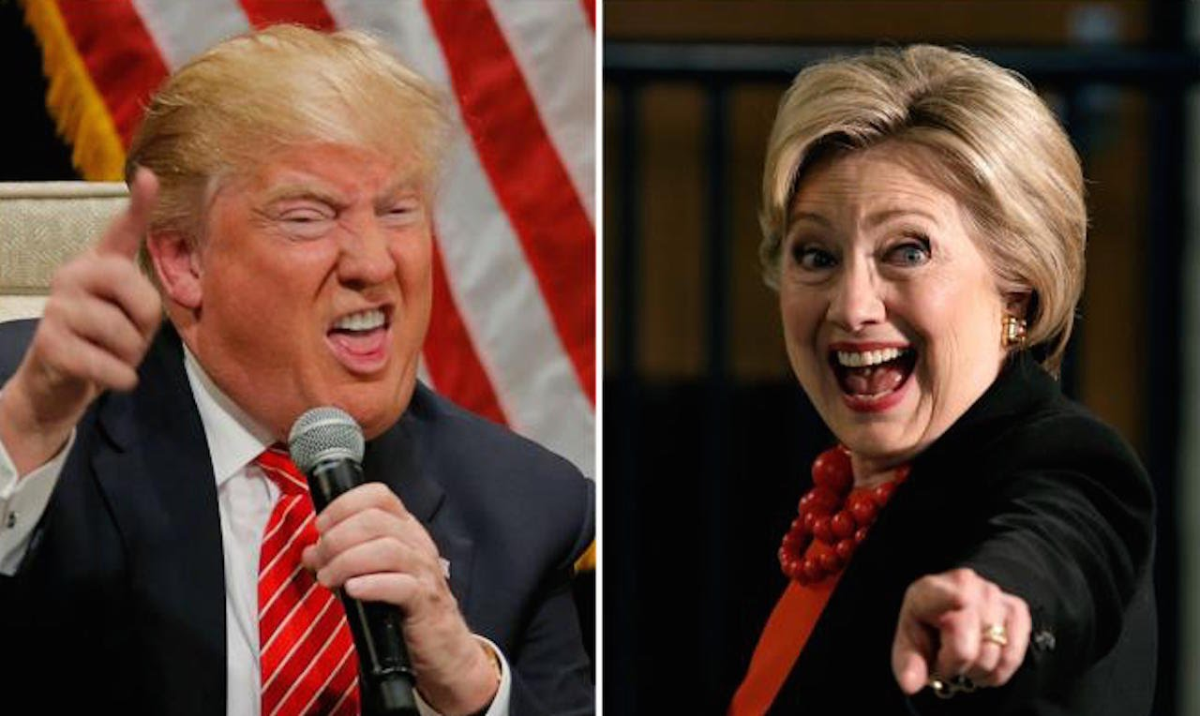
Polarization is everywhere!

Slide 3
Our research
Understanding polarization on social media
Identifying polarized topics automatically
Reducing polarization

Slide 4
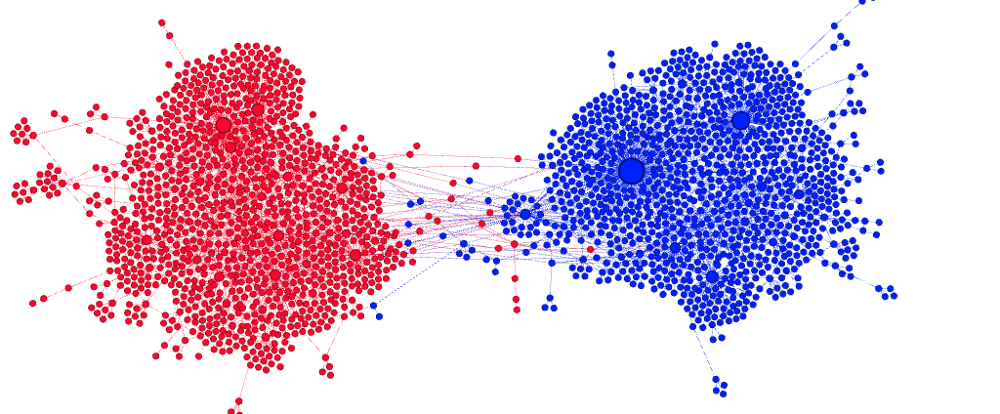
Identifying polarization
retweet graphs
Identifying and quantifying polarized discussions
#beefban
#russia march
#sxsw
#germanwings
polarized
Not polarized
Notes:
Talk about what a topic is!!

Slide 5
Reducing polarization

Slide 6
How can we bridge the divide?
Connect the two sides
E.g. Recommend a user from one side to follow/retweet/read content from the other side
Notes:
You can pose this as an optimization problem on a graph

